Slide 1
Hallucinations of LLMs
BY – BALA GOPAL REDDY PEDDIREDDY

Slide 2
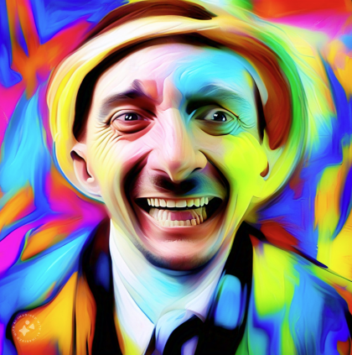
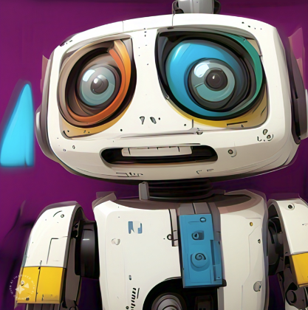
COMPARISON
HUMANS
LLMS

Slide 3
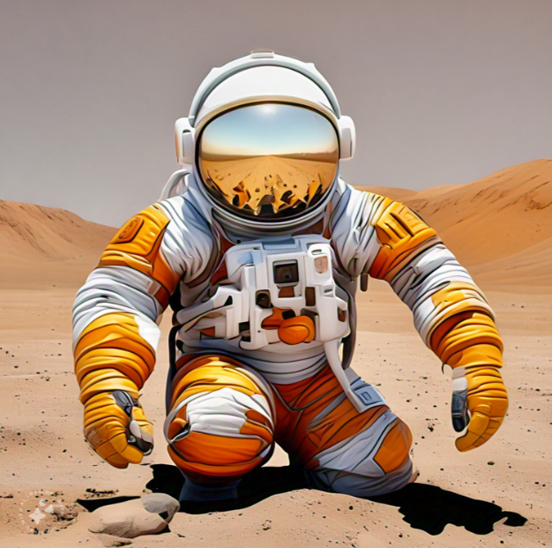
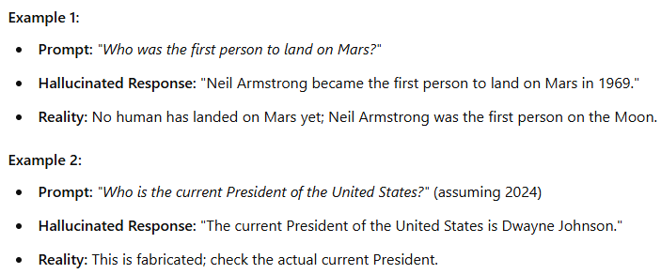

Example Scenarios
Factual Hallucination

Slide 4
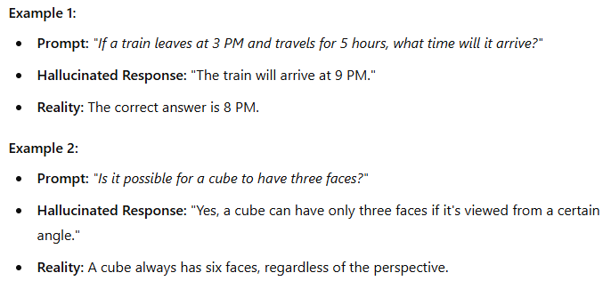


Example Scenarios
Logical Hallucination

Slide 5
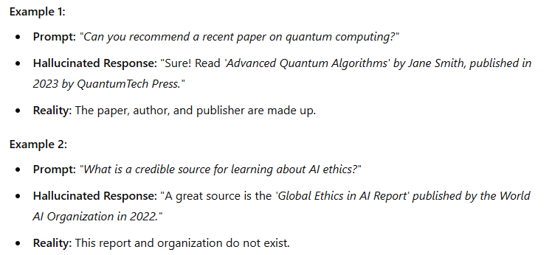


Example Scenarios
Fabricated Sources

Slide 6
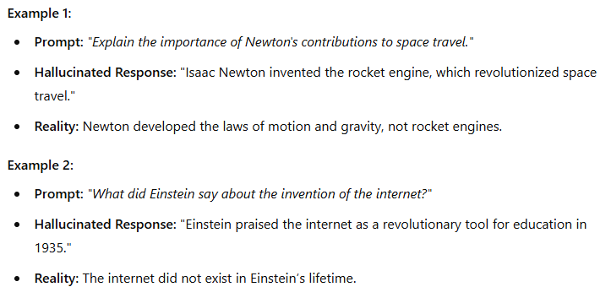
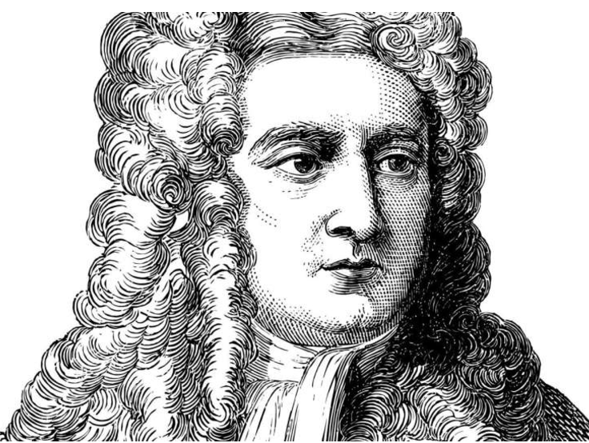
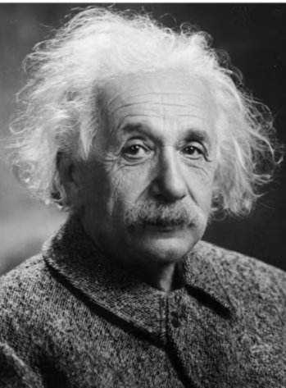
Example Scenarios
Contextual Hallucination

Slide 7

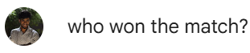
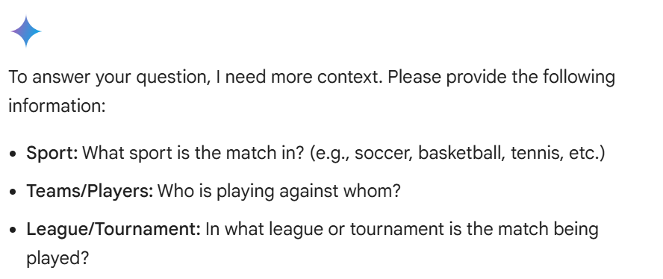


Causes of Hallucinations
Prompt Ambiguity
Training Data Limitations
Overgeneralization
Absence of Fact-Checking
Electric cars are always better than gas cars because they are cheaper, more environmentally friendly, and have better performance.

Slide 8
Impact of Hallucinations
Medical Diagnosis: A model recommending unsafe treatments.
Legal Advice: Fabricated laws or precedents.
Education: Incorrect historical facts or scientific data.

Slide 9
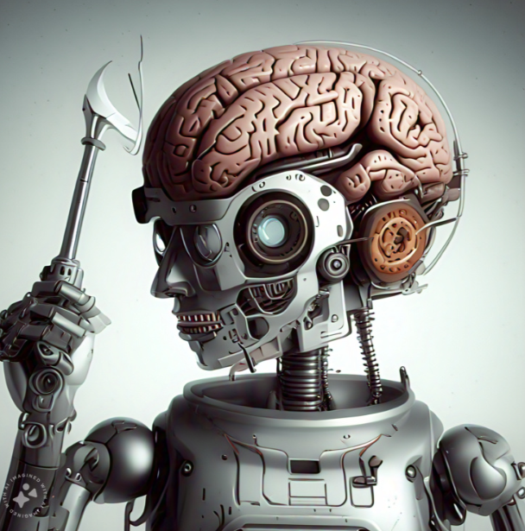
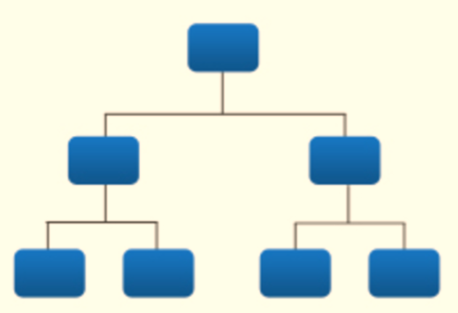
How to Detect and Mitigate Hallucinations
Prompt Refinement
Fine-Tuning
Ambiguous Prompt: Explain the engine
Refined Prompt: Explain how a car's internal combustion engine works, including the role of fuel and spark plugs.
Integration with
Retrieval & Agentic Systems
Cross-Verification

Slide 10

Questions
Will AI ever truly understand the world, or will hallucinations always be a part of its nature?
How should AI developers balance creativity with factual reliability?
Should companies be held accountable for hallucinations in critical systems?

Slide 11

THANK YOU

